Slide 1
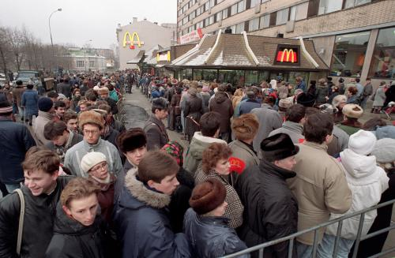
case: McDonald’s - a global cultural icon?

Slide 2
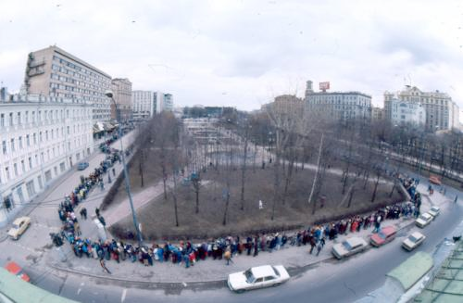

Slide 3
How would you describe McDonald’s global marketing
strategy: is it a hard globaliz standardizeder or does it
adjust to local contexts? What are the reasons for its
choices?
What is a cultural icon? To what extent is McDonald’s as a
corporate name, and its product brand names (e.g. Big
Mac) associates with its country of origin (the US) and to a
large-scale, standardized service operations?
Describe the ambivalent attitudes of consumer to McDonald’s.
Do boycotts really succeed in stopping the growth of
McDonald’s outside the US? Base your answer on actual
data.
How should McDonald’s react to boycotts in the short run? In
the long run, how could the company avoid being
considered a mere cultural icon?

