Slide 1
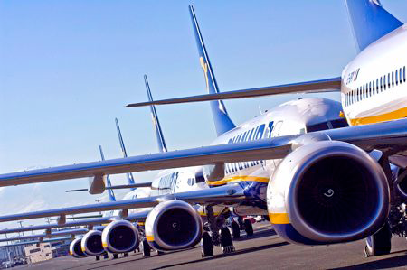
Ryanair

Slide 2
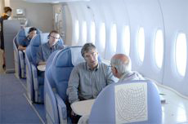
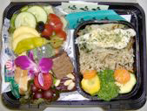
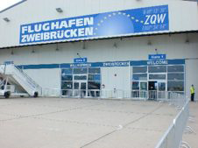
component one: efficiency

Slide 3
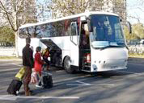
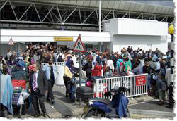
component two: calculability

Slide 4
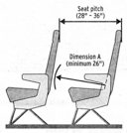
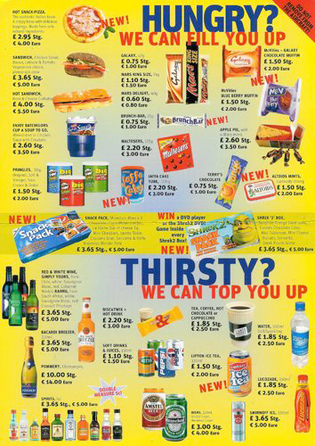
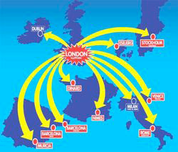
component three: predictability

Slide 5
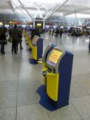
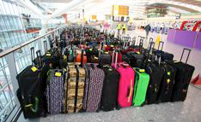
component four: control (through nonhuman technology)

Slide 6
Modern cultures
Individualist culture
Strong emphasis on material achievements – doing/ having not
being
Strongly economic, „commoditized“ time
Tendency to discard past in favor of future orientation
Fairly high degree of utilitarianism

Slide 7
culture bound products
Rich or poor cultural context of product
Relationship to the physical environment
Cultural or national background/ identity
Language
Products that involve a relationship to others
Complex products
Nature of the product

Slide 8
wine vs beer consumption in Europe

Slide 9
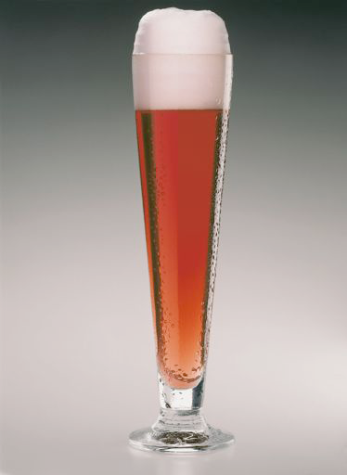
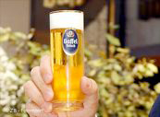
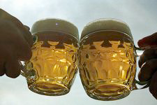
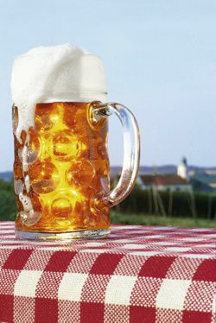
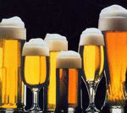
Beer cultures

