Slide 1
JD- 1\2 & Erasmus
1st class
Me, you & us…
By Pedro Coelhoso ☺
The presentation contains lots of copyrighted materials and ideas as well as stories that might be not true. For the sake of education, the author pleases not to sue him if some materials will spread beyond this classroom.

Slide 2
Dear Clients,
Teaching slides:
•Will be send to you via email or via website.
Please remember - I have several
students! Full name, university, purpose.. In your works deliver or any emails.
•Mobile: +370 - 64192257 (no SMS please unless particular and not related with classes or work)
Contact hours:
•on request
Regards,
THE BOSS

Slide 3
4 lines….
Cross all the 9 dots…

Slide 4
“THINK OUTSIDE THE BOX”

Slide 6
AGENDA
Short background on me -more or less to break the ice between me and the audience (we are not that different).
My life…Some talk about motivation & inspiration -work hard to achieve something.
3. Effects and people…goals and objectives
Classes
5. You!!

Slide 7
Me and why?
João Pedro Coelhoso 24 years, Portuguese
Graduated in Public Relations, Marketing in 2008-2009 in ISMAI,(Instituto Superior da Maia), Porto,(Portugal)
University of Sevilla – Communication, 2007, Spain (Specialization)
Honour mention of best student of the year
Award of best student of Pr degree
Scholarship of best student in ISMAI, Porto. Mba,(Management and Business Administration in Vilnius University 2009-2010, Vilnius, (Lithuania) Internship in the Embassy of Portugal in Lithuania -Taurus Eventus
Image and Marketing.
Political Marketing in image and Assistent Manager.
Instructor in Smk
Guest Speaker:
VKK, Vilnius- Lithuania
IPB, Braganca- Portugal

Slide 8
IN LIFE:
I like party, movies, be with friends and music,
I have 600 and something friends in facebook,
643 in hi5,
Have my own website (WWW.PEDROCOELHOSO.WEEBLY.COM)
My own book
Last book that i read was “Present like steve jobs”
I like beer, and more a less the same things than all of you..WE ARE NOT DIFFERENT

Slide 9
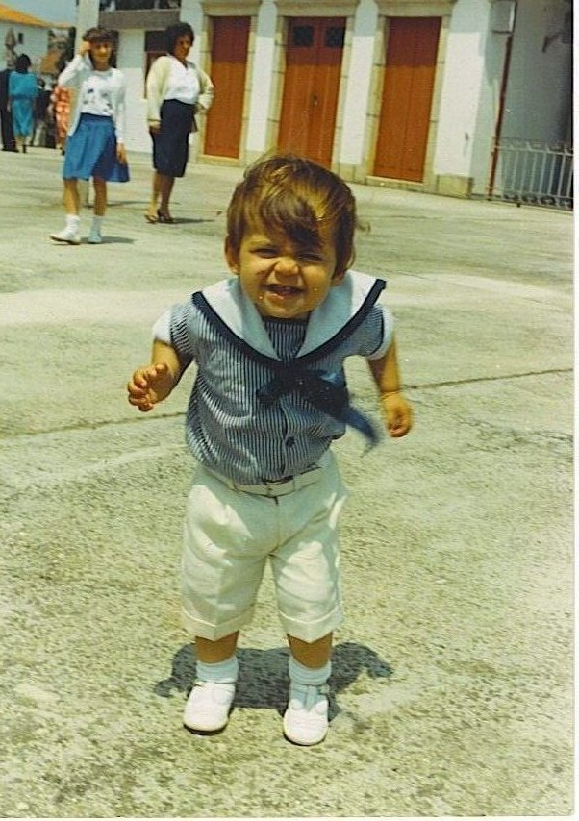
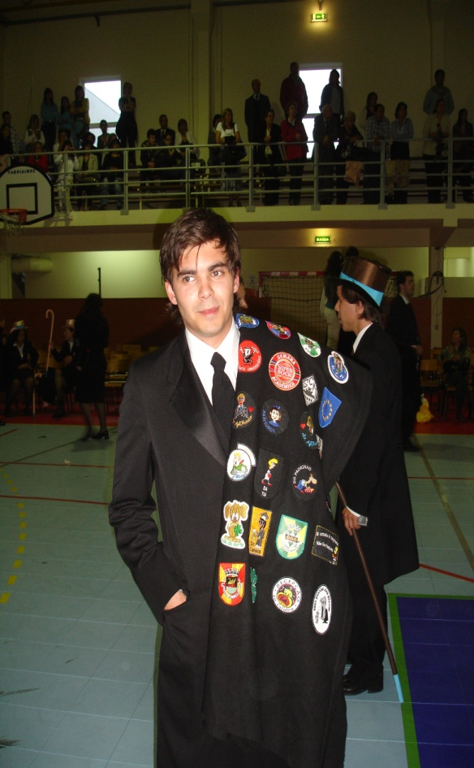
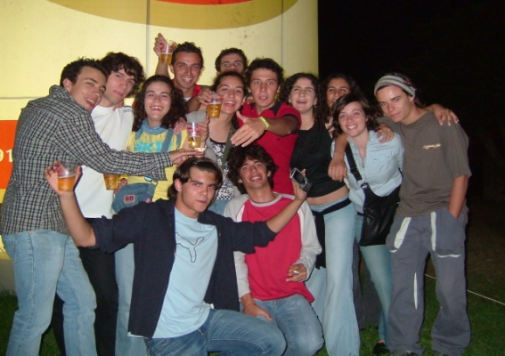
2. My life

Slide 10
3.Think big… Success and failure…
1
Worked hard
2
Had problems
3
Achieved

Slide 11
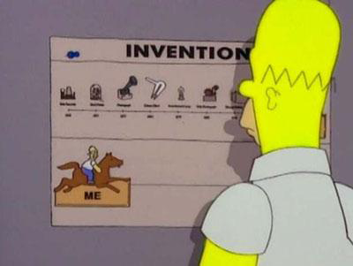
„Brick walls are there to separate you from those who don‘t really want it“

Slide 12
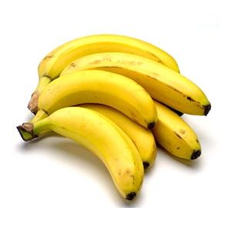
Monkey effect…
PEOPLE
WALL/PAIN
GOALS

Slide 13
4.CLASSES
ATTENTION
FOR THE FOLOWING RULES, NORMS AND EXPLANATIONS

Slide 14
RULE # 1
YOU CANNOT USE A PENCIL OR A PEN

Slide 15
RULE #2
YOU ARE FREE TO SIT EVERYWHERE YOU WANT- (THAT ALSO MEANS THE FLOOR)

Slide 16
RULE # 3
BOOKS OR PAPERS ARE NOT ALLOWED- (UNLESS EXERCISE OR THAT I WILL GIVE YOU)

Slide 17
RULE #4
YOU ARE OBLIGE TO PARTICIPATE

Slide 18
RULE# 5
YOU CAN GET IN OR GO OUT FROM THE CLASS WHEN YOU WANT (JUST DO IT IN SILENCE)

Slide 19
RULE #6
YOU CAN BRING FOOD OR DRINKS TO THE CLASS

Slide 20
RULE # 7
MINIMUM 75% ATTENDANCE

Slide 21
RULE # 8
INTERRUPTIONS ARE ALWAYS WELCOME SPECIALLY IF RELEVANT

Slide 22
RULE #9
PLEASE SHARE YOUR IDEAS WITH OTHERS

Slide 23
RULE # 10
MOST OF ALL- HAVE FUN ALWAYS

Slide 24
GRADE SYSTEM
Final exam- 40%
Paper-30%
Participation-10%
Mid-term or other evaluation test- 20%

Slide 25
Academic paper???? What is that!!
Scope
•The main points of the topic must be covered
•General information should be very limited and support the argumentation
Structure
•Introduction and conclusion should deserve their name
•Outline should be logically build up
•Parts should flow into each other
•Structure should support readability (sub-headers, enumeration of points, …)

Slide 26
Academic paper- part 2
Argumentation
•General arguments should be supported by fitting examples
•Examples should be summarized into findings or
generalizations
•Graphs and tables should support argumentation and not
serve as decoration
Originality (Parts of the paper should be genuine)
•Criticism of official statements, conventional knowledge or
theoretical concepts
•Outlook into the future, application of findings into other
areas

Slide 27
Academic paper attacks!!!
Google: “how to write a paper”
Formalities:
•2000 words per team member(in case of teams)
•Length +/- 10% is ok
•Citation (citation style does not matter)
•(internet sources only with entire domain (not just:
www.oecd.org)
•Bibliography
•Spell-Check(obligatory)
•Grammar: (Only taken into account when text is incomprehensible)

Slide 28
Research ??? Omg!!! I just know copy-paste!!!
Sources
•Quantity: 15 sources is minimum (below deduct points)
Citations e.g- according to Pedro(2004),…
Good standard:
•Quotation of primary and official documents as well as of comments
Balanced resources: pro- and cons
•Academic papers used
Bad standard:
•Mainly journalistic sources
•Only rephrasing official statements
•One-sided literature
P.S- WIKIPEDIA IS NOT AN ACADEMIC SOURCE

Slide 29
POLITICAL CORRECTNESS…
Guideline for ANY discussion about cultures:
•Be honest!
•No political correctness please!
•“Unity in diversity” MEANS that there are differences
•Constructive criticism is at the heart of a pluralistic society!
•Cultural studies are interpretive studies

Slide 30
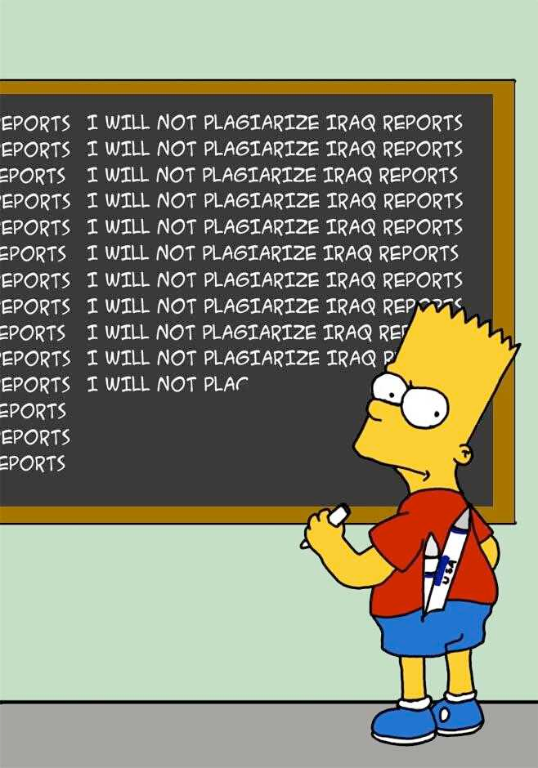
The Myth of plagiarism!!
Copy from one book = plagiarism
Copy from two books = an essay
Copy from three books = a compilation
Copy from four books = a dissertation
Copy from Wikipedia = term paper

Slide 31
Some words about plagiarism…
Plagiarism is the practice of claiming, or implying, original authorship, or incorporating material from someone else's written or creative work in whole or in part, into ones own,without adequate acknowledgment.
Within academia, plagiarism by students, professors, or researchers is considered academic dishonesty or academic fraud and offenders are subject to academic censure
(from wikipedia)

Slide 32
My best friend!!
Some of the fast food can (Link) [...] be quite delicious and it is (Link) [...] almost always inexpensive
The restaurant chain [...] may lack interesting variety but you (Link) [...] will usually be assured of good
(Link) [...] service consistent quality and clean facilities [...] When you visit different restaurants
belonging (Link) [...] to the same fast-food chain the (Link) [...] menu and food are pretty much (Link)
[...] the same But is it realy [...] the same ( bookrags com/research/1920s-food-and-drink-bbbb-02/fastfood-
bbbb-02 html) [...] ( mcdonalds com/corp/about/mcd_history_pg1 html) 1 Fast [...] food
differences between Britain and USA [...] English people like to spend their (Link) [...] free time in
numerous pubs where (Link) [...] they can have a glass of (Link) [...] beer and talk about different
things (Link) [...] with their friends Though they eat [...] eggs and bacon with toasts for (Link) [...]
breakfast pudding or apple pie for (Link) [...] dessert but also in Britain eats [...] more fast food than any
other (Link) [...] country in Europe There are some [...] important differences between fast food in (Link)
[...] the USA and Canada compared to (Link) [...] Britain Unlike in Britain fast food [...] restaurants in the
USA and Canada (Link) [...] tend to be located outside the (Link) [...] centres of towns They are usually
(Link) [...] found on the main roads leading (Link) [...] in and out of town especially (Link) [...] near
Interstate and freeway exits On (Link) [...] toll-free highways there are no service (Link) [...] areas in the
USA or Canada (Link) [...] so the highway traffic uses the (Link) [...] same services such as restaurants
and (Link) [...] gas stations (petrol stations) as the (Link) [...] people in each town In the [...] USA and
Canada each fast food (Link) [...] restaurant is normally a separate detached (Link) [...] building in the
chain's own architectural (Link) [...] style with its own large free (Link) [...] outdoor car park surrounding
it Almost (Link) [...] all fast food restaurants have drive-thru's (Link) [...] for the takeaway trade As in [...]
Britain the majority of fast food (Link) [...] restaurant chains target their advertising at (Link) [...] young
children believing that in most (Link) [...] cases they make the decision as (Link) [...] to where a family
eats However (Link) [...] fast food restaurants in the USA (Link) [...] and Canada are widely used by
(Link) [...] all ages and all classes for (Link) [...] breakfast lunch and evening meal The (Link) [...]
ignorant snobbish rejection of fast food (Link) [...] by some people in Britain very (Link) [...] largely does
not apply in the (Link) [...] USA or Canada Many of the [...] fast food chains in the USA (Link) [...] and
Canada prepare hot food only (Link) [...] when it is ordered using the (Link) [...] order number system
When you order (Link) [...] and pay you are given a (Link) [...] receipt with your order number
prominently (Link) [...] marked on it When your order (Link) [...] is ready your order number is (Link) [...]
announced In the USA and Canada [...] more than adequate seating and tables (Link) [...]

Slide 33
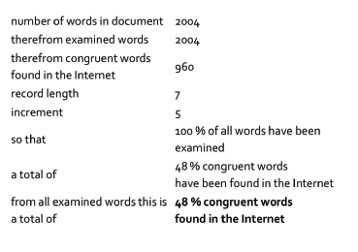
Your best friend – Plagiarism checker

Slide 34
THAT‘S ALL FOLKS!
If you have some questions, please feel free to contact me:
Pedrocoelhoso.rp@gmail.com

