Slide 1
MARKETING
PEDRO COELHOSO

Slide 2
linguistics aspects of brands
Phonetic devices
•Coca Cola, Omo, Tic Tac, Chevy (for Chevrolet), Dash…
Orthographic devices
•Kool-Aid, 7Up, HP, P&G..
Morphological devices
•Tipp-Ex
Semantic devices
•Aqua Fresh, Kinder, Nutella

Slide 3
Discuss the international transferability of the following
assemblages:
•Pizza – Dr Oetker – Pizza Rustica – Germany
•Computer chip – Intel – Pentium – US
•Drilling tool – Bosch – Fuchsschwanz – Spain
•Car – Daewoo – Nexia – South Korea
•Tomato sauce – Mars – Dolmio – Holland
•Insecticide – Bayer – Baygon - Germany
Why is Dr. Oetker producing in France under the name Ancel?

Slide 4
Discuss the possible international extention of following
brands:
•Müller (Germany)
•Barilla (Italy)
•P & G
•Teysseire (French syrups)
•Roi des Montagnes (French dried mush.)
Nestlé decided to use directly its company name for all of its
milk based products in China. Discuss why?

Slide 5
Nestlé (Nescafe)
•in Spanish: “No es café” or "It isn't coffee."
Chevy Nova
•in Spanish "Nova" means "doesn't go"
"Pepsi Brings You Back to Life"
•in Chinese "Pepsi Brings Your Ancestors Back from the
Grave"
Parker Pen
•"it won't stain your pocket and embarrass you“ – in Spanish
"it won't stain your pocket and get you pregnant."
Gerber baby food had baby on the label
•in Africa, companies routinely put pictures on the label of
what's inside
•Gerber = to vomit (in French)

Slide 6
Verbal vs. non verbal
Ethnocentrism
•tendency to look at the world primarily from the perspective of
one's own culture.
Stereotypes vs. Prejudices
Whorfian hypothesis
•Business people from different cultures communicate in
different ways but also perceive, categorize and construct
their realities differently
Linguistic ethoc. vs. Linguistic polyc.

Slide 7
culture and advertising execution: relative!
Language
Characters and roles representative
Influence of more and religion
Visual elements of advertising
Target groups
Media types
Humor

Slide 8
Exchange at a French dinner party at the time of General
DeGaulle's retirement:
•Dorothy MacMillan: "What are you most looking forward to in
these retirement years?“
•Madame DeGaulle: "A penis."
[Shocked silence]
•General DeGaulle: "My dear, I think the English don't
pronounce the word quite like that. It's not 'a penis' but
'appiness'."
Car attribute importance
•France vs. Germany vs. Italy vs. UK
Unleaded gas
•Europe vs. South East Asia

Slide 9
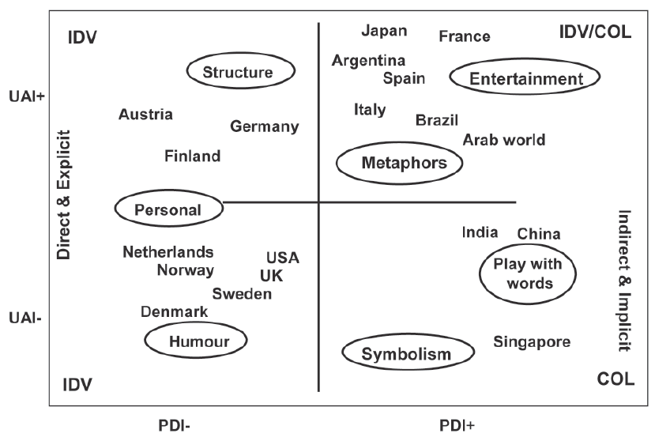

Slide 10
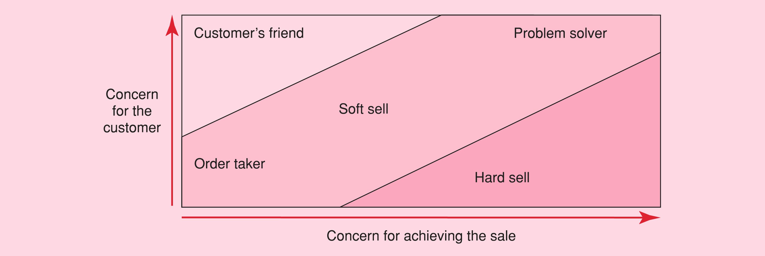
selling orientation

Slide 11
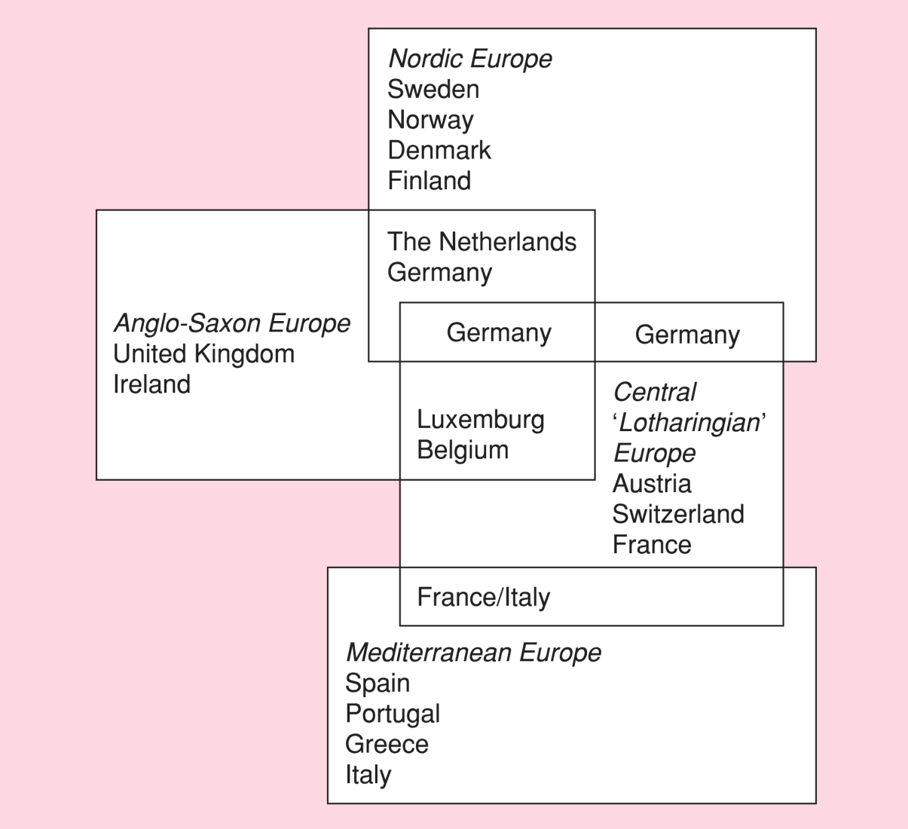
Traditional after geography Global transnational segments Ethnicity and ethnic segments Cultural affinity classes Cultural affinity zones

Slide 12
global country segmentation
Country level
•Market size, geography, language, climate
Individual level
•Demographic, brand loyalty, product usage, buying patterns,
psychographic
Demographic clusters
•Age, material status, education, income
Attitudinal clusters
•Environmental beliefs, faith in others
Behavioral clusters
•Willingness to pay, effort

Slide 13
why marketing adaptation is necessary?
92% culture
87% market dev.
84% competition
82% laws
78% economic differences
74% sociological consideration
71% customer perception
60% technological consideration
53% political environment
49% level of customer similarity

Slide 14
A car :
•Steel+ plastics+ length+ weight, etc.
•Number of persons, guarantee, gas mileage, level of comfort
•Luxury, economy, dynamism, sporty
PHYSICAL, SERVICES, SYMBOLS

Slide 15
dimensions of service quality
Tangibles
•Physical appearance of business, HR & sales literature
Reliability
•Performing the promised service (on/ in time)
Responsiveness
•Good customer service (quickly & honestly)
Assurance
•Degree of trust culture & respect
Empathy
•Giving the customers a feeling of being interested in their
problems

Slide 16
whisch country is parent !!!
Image:
USA
UK
USA
??????
??????
France
??????
Canada/Czech R.
Scandinavia
Germany/France
??????
Sweden
Parent Country:
Japan
Germany
UK
Austria
Lithuania
Canada
Germany
Switzerland
USA
Luxembourg
Switzerland
Netherlands
Corporation:
Bridgestone
Rolls-Royce
Holliday Inn
Red Bull
InyourPocket
Cirque du Soleil
Puma
Bata Shoes
Radisson SAS (B)
RTL Group
Adecco
IKEA

Slide 17
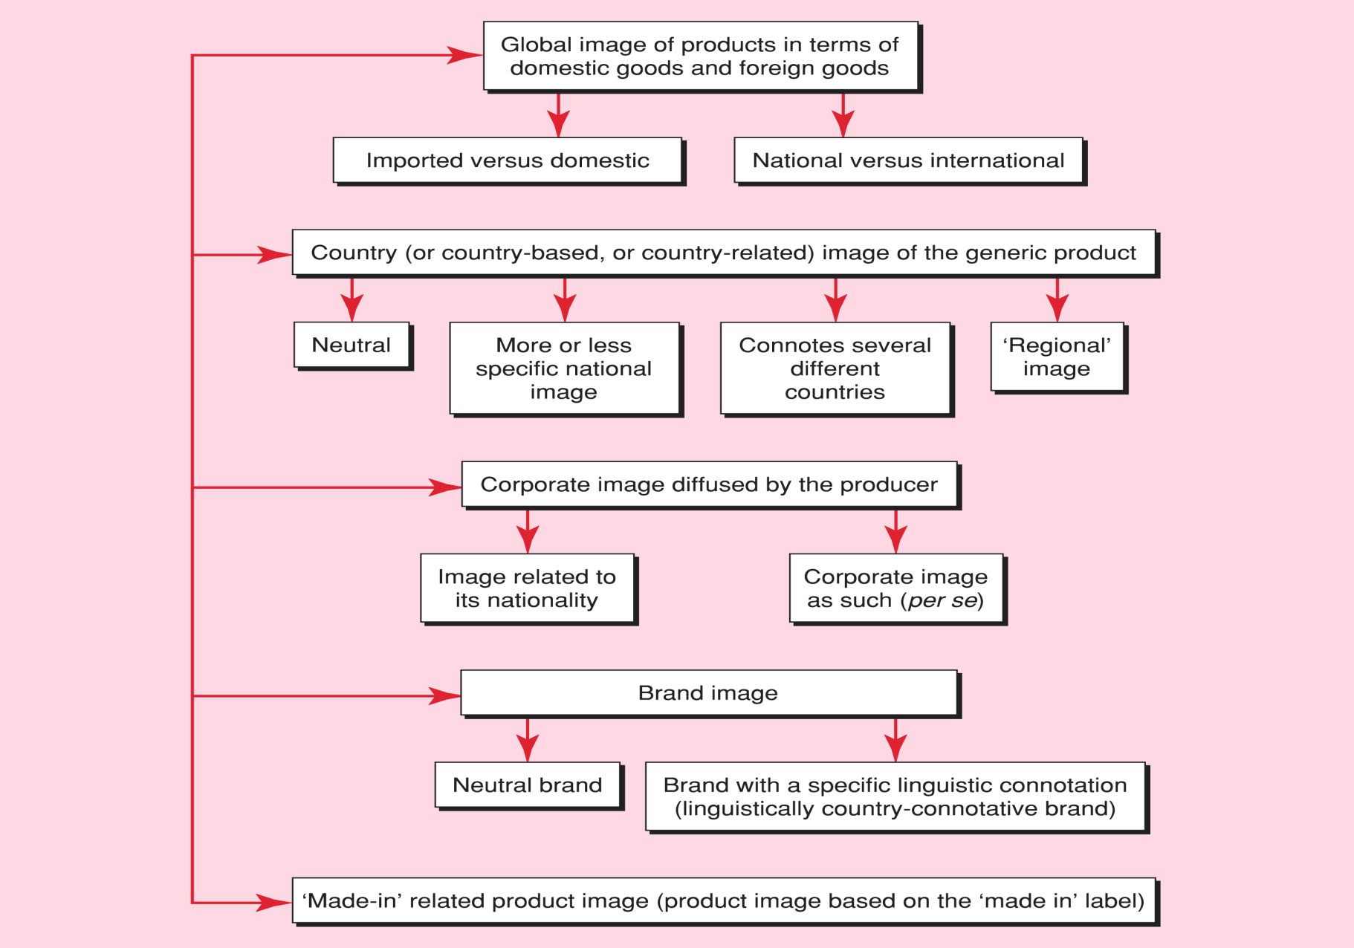

Slide 18
Discuss to what extent (for following products):
•A world consumer exists??
•Products/ services are themselves global
•The industry itself can be considered as global
•Airlines
•Beer
•Pharmaceuticals
•Tobacco
•Meat based foods
•Toilet tissues
•Blood analyzer
•Mail service
•Sheets & pillows
•Ski lifts
•Notebooks
•Washing machines

Slide 19
political aspects of the marketing environment
Political Risks
•Nationalization, contract revocation, reparation of funds,
treatment of expatriate personal
Economic Risks
•Exchange controls, tax controls, price controls, import
restrictions
Assessing political vulnerability
•Government vs. Business
•Possible solutions and actions

Slide 20
legal aspects of the marketing environment
Legal environment
•International law vs. „no one“ universal law
Basis of legal systems
•Common law, Islamic law, civil or code law, Socialist law
Legal issues
•Laws within a country
•Evolving cyber laws

Slide 21
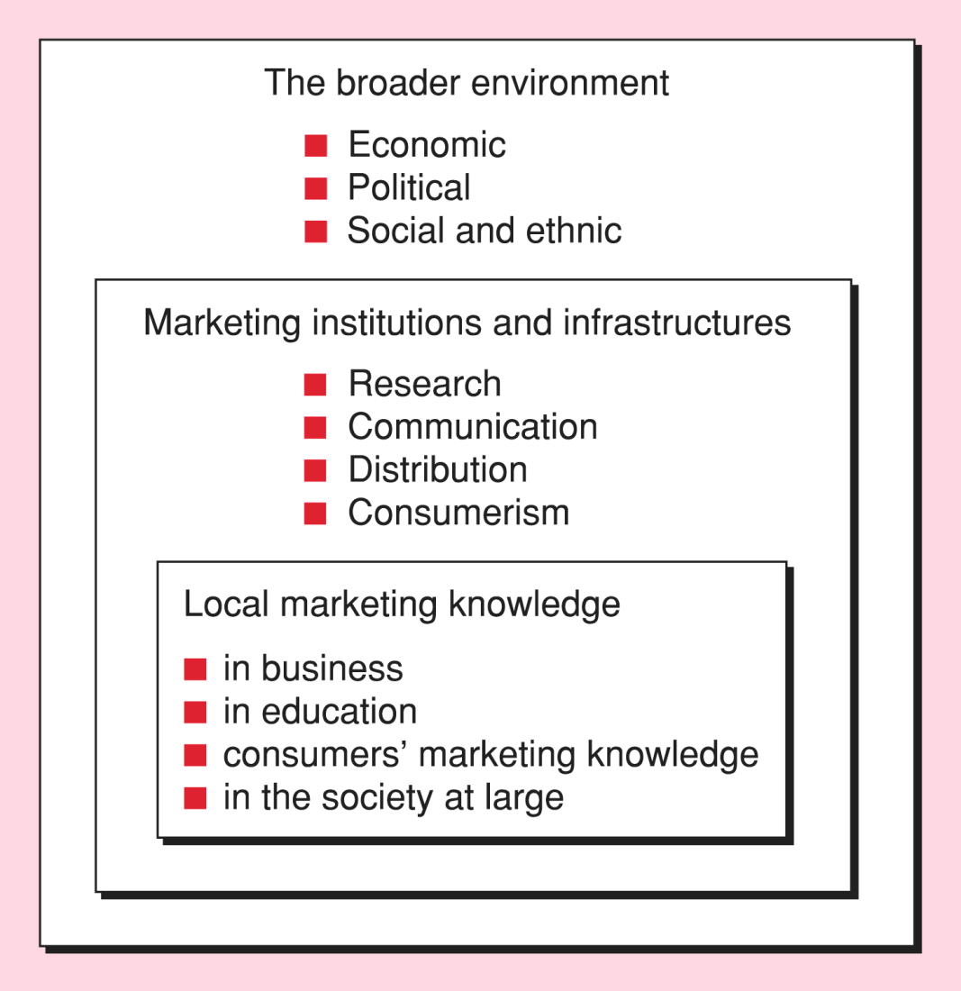

Slide 22
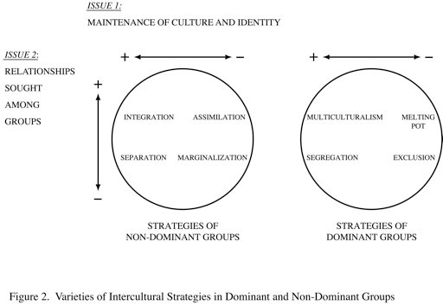

Slide 23
understanding contextual and cultural influence
Power: Sugary products, large breakfasts, bowling electric
trains, power tools
Masculinity: Coffee, red meat, heavy shoes, strong alcohol,
shaving with razor
Individuality: Vodka, foreign cars, cigarette holders, perfume,
gourmet food
Status: Scotch, ulcers, heart attacks, indigestion, carpets
Social acceptance: ice-cream, coffee, toys, sugar, soap, beauty
products
Eroticism: Sweets, gloves, a men lightening a woman‘s cigaret

Slide 24
Behaviour!!
Voice consumer complaint behavior:
•Forget about the incident and do nothing
•Complain to store manager next time
•Immediately complain by repair shop
Private consumer complaint behavior:
•Decide not to use the repair shop again
•Speak to your friends about experience
•Convince friends not to use shop again
3rd party consumer complaint behavior
•Complain to consumer agency
•Write to newspaper or take legal actions?

Slide 25
country of origin effects
Many consumers may take into consideration the country of
origin of a product. The “Made in” label matters a great
deal to some consumers
Country of origin effects vs. country of origin bias
•Whereby COO effects deal with the quality perceptions of
products (differing by product category and quality level
of the country of production), a bias is an over/
understatement of product attributes.
Key findings:
•COO effects are not stable; perceptions change over time
•Consumers prefer domestic products over imports
•The critical factor appears to be the place of manufacture
rather than the location of the company’s headquarters
•Demographics makes a difference
•COO effects depend on the product category

Slide 26
And???
Efficiency
•“... the optimum method from getting from one point to
another...”
Calculability
•“... refers to the quantitative aspects of products sold and
the service (in terms of time) it takes to obtain this
product”.
Predictability
•“...the assurance that products and services will be the
same over time and in all locales”
Control through nonhuman technology
•“...is exerted over people who enter the world of
McDonald’s.”

Slide 27
Irrationality
•A side effect of over-rationalized systems. Workers on an
assembly line that are hired and trained to perform a
single highly rationalized task - burnout.
Deskilling
•A work force with the minimum abilities possible to
complete simple focused tasks. This means that they
can be quickly and cheaply trained and are easily
replaceable.
Consumer Workers
•One of the sneakiest things about McDonaldization is how
consumers get tricked into becoming unpaid
employees. They do the work that was traditionally
performed by the company

